Slide 1


Slide 2
TestNG – An Introduction
Powerful Testing Framework: TestNG is a popular open-source framework that gives you a lot of control over how you write and run your automated tests
Successor to JUnit: Built upon the foundation of JUnit, TestNG offers additional features and a more user-friendly experience
Easy Test Control: TestNG allows you to easily define test case dependencies. You can ensure that specific tests run before others, mimicking real-world test workflows
Enhanced Functionality: Through annotations, grouping, test sequencing, and data-driven testing, TestNG provides more powerful and flexible ways to design your test suites

Slide 3
Features of TestNG
Supports object oriented programming​
Uses annotation​
Prioritizes the task​
Parameterization​
Test Reports​
Groups​
XML​
In-built Exception Handling​
It covers unit, functional, end-to-end andIntegration testing.​
Cross browser testing ​

Slide 4
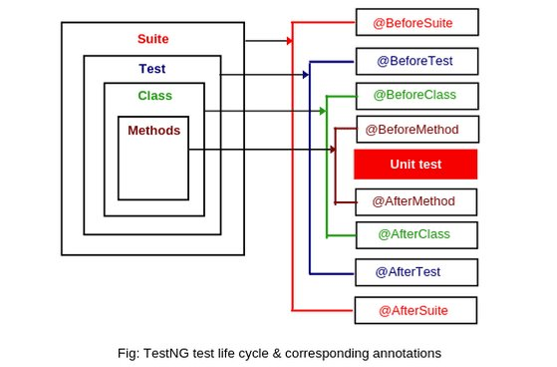
TestNG Annotations
Annotations are metadata tags prefixed with @ that tell TestNG how to handle methods during test execution
They define the execution flow, setup/teardown routines, grouping, parameterization, and more

Slide 5
TestNG Annotations
Annotation | Purpose | Example Usage
@BeforeSuite | Runs once before all tests in the suite | @BeforeSuite public void setupSuite() {}
@AfterSuite | Runs once after all tests in the suite | @AfterSuite public void tearDownSuite() {}
@BeforeTest | Runs before any test method in <test> tag in testng.xml | @BeforeTest public void setupTest() {}
@AfterTest | Runs after all test methods in <test> tag | @AfterTest public void tearDownTest() {}
@BeforeClass | Runs before the first method in the current class | @BeforeClass public void setupClass() {}
@AfterClass | Runs after all methods in the current class | @AfterClass public void tearDownClass() {}
@BeforeMethod | Runs before each test method | @BeforeMethod public void setupMethod() {}
@AfterMethod | Runs after each test method | @AfterMethod public void tearDownMethod() {}
@Test | Marks a method as a test case | @Test public void testLogin() {}
@DataProvider | Supplies data to a test method | @DataProvider(name="data") public Object[][] getData() {}
@Parameters | Passes parameters from testng.xml to test methods | @Parameters({"username"}) public void testUser(String username) {}
@BeforeGroups | Runs before any test method in specified group | @BeforeGroups("regression") public void setupGroup() {}
@AfterGroups | Runs after all test methods in specified group | @AfterGroups("regression") public void tearDownGroup() {}
@Listeners | Registers custom listeners for logging/reporting | @Listeners(MyListener.class)
@Factory | Dynamically creates test class instances | @Factory public Object[] createTests() {}

Slide 6
Enabling and Disabling tests in TestNG
@Test(enabled = true) // This is used to run/execute the test method​
Public void method1(){​
----​
}​
@Test(enabled = false) //This is used to skip/ignore the test method​
Public void method2(){​
----​
}​
​
By default, TestNG considers enabled=true​
This helps in efficiency of the test.

Slide 7
TestNG Prioritization
Syntax:
@Test(priority=0)​
public void method(){​}​
If test priority is not mentioned, then the default priority is “0”.​
If priority is set for one method in test suite, it is mandatory to set the priority for other methods as well. ​
Negative priority is acceptable in TestNG​
The methods can have same priority - these case TestNG will execute the methods in alphabetical order of method name.​
A lower priority value means the test will execute earlier.​
A higher value will push the test to execute later.​
​

Slide 8
TestNG Parameters
TestNG parameters provide a flexible way to pass values to test methods, enhancing test reusability and making it easier to perform data-driven testing​
​Features of testNG parameters:​
  Simplified value passing​
  Efficient value storage and reuse​
  Flexibility​

Slide 9
Parameter Type | Purpose | Example Usage
@Parameters | Pass simple values from testng.xml to test methods | Parameters("browser")<br>public void launch(String browser)
@Optional | Provide default value if parameter is missing in testng.xml | @Parameters("env")<br>public void test(@Optional("QA") String env)
@DataProvider | Supply multiple sets of data to a test method programmatically | @DataProvider(name="loginData")<br>public Object[][] data() {...}
dataProviderClass | Use a @DataProvider from another class | @Test(dataProvider="dp", dataProviderClass=ExternalData.class)
parallel (XML) | Run data-driven tests in parallel | <suite data-provider-thread-count="5">
@Factory | Dynamically create test instances with parameters | @Factory public Object[] createTests() {...}
XML <parameter> | Define parameter values in testng.xml | <parameter name="browser" value="chrome"/>
Parameter Precedence | Override parameters at different levels: suite < test < class < method | <parameter name="env" value="prod"/> under <method> tag

Slide 10

Example
@Parameters("browser")
@Test
public void launchBrowser(@Optional("firefox") String browser) {
System.out.println("Launching: " + browser);
}
XML File:
<suite name="Suite">
<parameter name="browser" value="chrome"/>
<test name="Test">
<classes>
<class name="tests.LoginTest"/>
</classes>
</test>
</suite>

Slide 11
Assertions in TestNG
Assertions are used to verify expected vs actual outcomes in test cases
They help determine if a test passes or fails
Common use cases:
  Validating page titles
  Checking element visibility
  Confirming data values
Types of Assertions:
  Hard Assertions – Stops test execution immediately on failure
  Soft Assertions - Continues execution even if assertion fails; reports all failures at the end

Slide 12
Hard Assertions
Method | Purpose
assertEquals() | Checks if two values are equal
assertNotEquals() | Checks if two values are not equal
assertTrue() | Verifies a condition is true
assertFalse() | Verifies a condition is false
assertNull() | Checks if an object is null
assertNotNull() | Checks if an object is not null
assertSame() | Checks if two references point to the same object
assertNotSame() | Checks if two references point to different objects
Hard assertions are used to validate conditions immediately
If an assertion fails, test execution halts at that point
Ideal for critical validations where failure should stop further steps
Useful in:
  Login validations
  API response checks
  Critical UI element presence

Slide 13
Soft Assertions
Aspect | Hard Assertion | Soft Assertion
Execution Flow | Stops immediately on failure | Continues execution despite failures
Failure Reporting | Reports first failure only | Reports all failures at once
Use Case | Critical checks | Multiple validations / UI testing
Method Invocation | No extra method needed | Must call assertAll()
Soft assertions allow test execution to continue even after failures
All assertion results are collected and reported at the end with assertAll() method
Useful for non-critical validations or bulk checks
Ideal for:
  UI form validations
  Field-level checks
  Regression testing

Slide 14
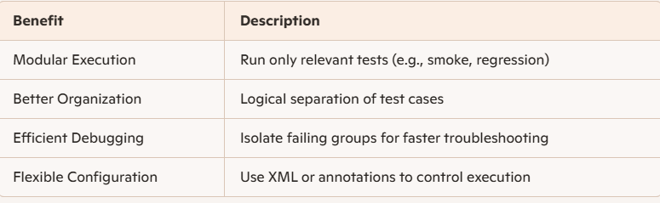
Grouping in TestNG
Grouping allows you to categorize test methods into logical units
Enables selective execution of tests based on functional areas, test types, or modules
Useful for managing large test suites with hundreds of test cases

Slide 15
Groups in Testng.xml
<!DOCTYPE suite SYSTEM "http://testng.org/testng-1.0.dtd">
<suite name="GroupedSuite">
<test name="RunSelectedGroups">
<groups>
<run>
<include name="sanity"/>
<include name="payment"/>
</run>
</groups>
<classes>
<class name="GroupingExample"/>
</classes> </test>
</suite>

Slide 16
Dependency Methods in TestNG
TestNG allows test methods to depend on other methods or groups
Ensures that prerequisite tests run first
Prevents execution of dependent tests if prerequisites fail
Helps maintain logical test flow and data integrity
Why use Dependency methods?
  Avoid running tests that rely on failed setups
  Enforce execution order without using priorities
  Improve test suite reliability and maintainability

Slide 17
Dependency Methods
Type | Description
dependsOnMethods | Specifies method-level dependencies
dependsOnGroups | Specifies group-level dependencies
alwaysRun=true | Ensures dependent method runs even if prerequisite fails (soft dependency)

Slide 18
Examples – dependsOnMethods
@Test
public void openApp() {
System.out.println("Openingapplication");
}
@Test(dependsOnMethods = {"openApp"})
public void login() {
System.out.println("Logging in");
}

Slide 19
Examples - dependsOnGroups
@Test(groups = {"init"})
public void setupDatabase() {
System.out.println("Setting up DB");
}
@Test(groups = {"init"})
public void setupEnvironment() {
System.out.println("Setting up environment");
}
@Test(dependsOnGroups = {"init"})
public void runTests() {
System.out.println("Running tests");
}
<!DOCTYPE suite SYSTEM "http://testng.org/testng-1.0.dtd" >
<suite name="GroupDependencySuite">
<test name="SetupRunTest">
<groups>
<run>
<include name="setup" />
</run>
</groups>
<classes>
<class name="your.package.GroupDependencyTestClass" />
</classes>
</test>
</suite>

Slide 20
Example - alwaysRun
@Test
public void init() {
Assert.fail("Simulated failure");
}
@Test(dependsOnMethods = {"init"},alwaysRun = true)
public void cleanup() {
System.out.println("Cleaning up...");
}

Slide 21
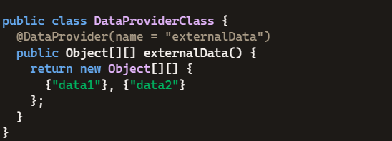
DataProvider in TestNG
A method that supplies data to a test method
Annotated with @DataProvider
Returns a 2D array of Object[][]
Enables running the same test with multiple data sets

Slide 22
Example
@DataProvider(name = "data-provider")
public Object[][] dpMethod() {
return new Object[][] {
{"First-Value"}, {"Second-Value"} };}
@Test(dataProvider = "data-provider")
public void myTest(String val) { System.out.println("Passed Parameter Is: " + val);}

Slide 23
Parallel Execution in TestNG
Parallel testing runs multiple tests simultaneously
Reduces total execution time
Ideal for large test suites and cross-browser testing
TestNG allows parallel execution at multiple levels:
Methods
Classes
Tests
Instances

Slide 24
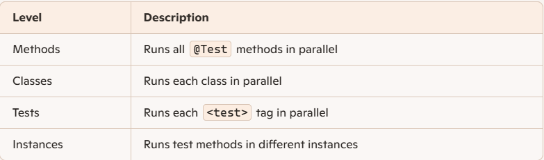

Slide 25
Examples
Methods:
<suite name="Parallel Suite" parallel="methods" thread-count="2"> <test name="Parallel Test">
<classes>
<class name="com.example.MyTestClass"/>
</classes>
</test>
</suite>

Slide 26
Classes:
<suite name="Parallel Suite" parallel="classes" thread-count="3">
<test name="Class Test">
<classes>
<class name="com.example.Test1"/>
<class name="com.example.Test2"/>
<class name="com.example.Test3"/>
</classes>
</test>
</suite>

Slide 27
Tests:
<suite name="Parallel Suite" parallel="tests" thread-count="2">
<test name="Chrome Test">
<classes>
<class name="com.example.ChromeTests"/>
</classes>
</test>
<test name="Firefox Test">
<classes>
<class name="com.example.FirefoxTests"/>
</classes>
</test>
</suite>

Slide 28
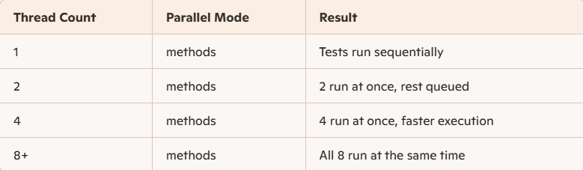
Thread- Count – What, Why, & How’s
It defines how many threads TestNG will use to run tests in parallel
The thread-count attribute is set inside the <suite> tag in your testng.xml
Higher thread count = more tests run at the same time
  If you set thread-count="10" and have 10 test methods, all can run concurrently.
Lower thread count = fewer concurrent tests
  With thread-count="2", only two test methods run in parallel; others wait in line.

Slide 29
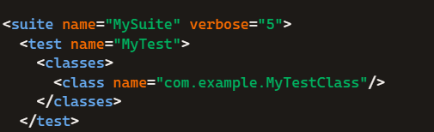
Verbose in testng.xml
It sets the logging verbosity level for TestNG
Accepts values from 0 to 10, where:
  0 = minimal output
  10 = maximum detail (includes internal decisions, listener activity, etc.)
Helps with debugging, especially when tests fail or behave unexpectedly.

Slide 30
Cross Browser Testing in TestNG
What is Cross-Browser Testing?
Testing a web application across multiple browsers and platforms
Ensures consistent behavior and appearance
Detects browser-specific bugs and rendering issues
a
Cross Browser Testing with TestNG
Achieved by passing parameters as browser

Slide 31
Test Class
@Parameters("browser")
@BeforeClass
public void setup(String browser) {
if (browser.equalsIgnoreCase("chrome")) {
driver = new ChromeDriver();
} else if (browser.equalsIgnoreCase("firefox")) {
driver = new FirefoxDriver();
}
driver.get("https://example.com");
}

Slide 32
XML File:
<suite name="CrossBrowserSuite" parallel="tests" thread-count="2">
<test name="ChromeTest">
<parameter name="browser" value="chrome"/>
<classes>
<class name="com.example.CrossBrowserTest"/>
</classes>
</test>
<test name="FirefoxTest">
<parameter name="browser" value="firefox"/>
<classes>
<class name="com.example.CrossBrowserTest"/>
</classes>
</test>
</suite>

Slide 33
Including and Excluding tests in testng file
Run only specific tests without modifying code
Skip unstable or irrelevant tests
Manage large test suites efficiently
How to Implement:
By method name
  By group name
  By package or class
  Using enabled=false in @Test annotation
  Using <include> and <exclude> tags in testng.xml

Slide 34
Example
Tests:
public class LoginTests {
@Test public void loginValid() {}
@Test public void loginInvalid() {}
@Test public void loginEmptyFields() {}
}
XML:
<classes>
<class name="LoginTests">
<methods>
<include name="loginValid"/>
<exclude name="loginEmptyFields"/>
</methods>
</class>
</classes>

Slide 35
Reporting in TestNG – TestNG Reports
Report Type | Location | Description
index.html | test-output/ | Summary of test suite execution
emailable-report.html | test-output/ | Email-friendly test summary
testng-results.xml | test-output/ | XML report for CI tools
junitreports | Optional | JUnit-style XML reports
Reports generated after test execution
Provide summary of passed, failed, and skipped tests
Help in debugging and tracking test results
Available in HTML, XML, and custom formats

Slide 36
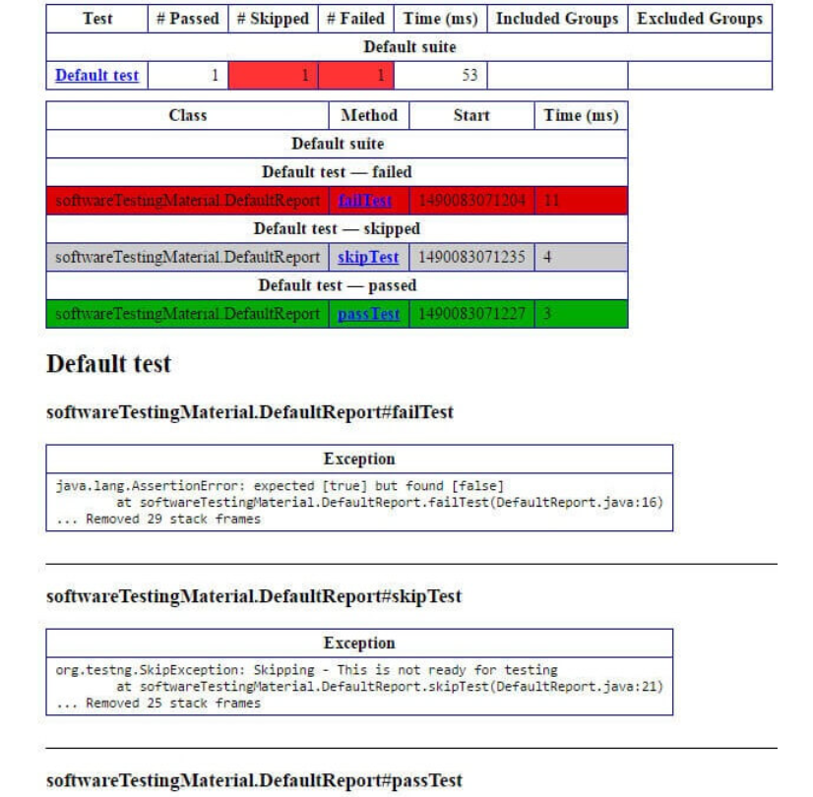
TestNG – Emailable Report
Lightweight HTML report
Shows:
  Total tests run
  Passed, failed, skipped
  Execution time
Can be sent via email or integrated into CI pipelines

Slide 37
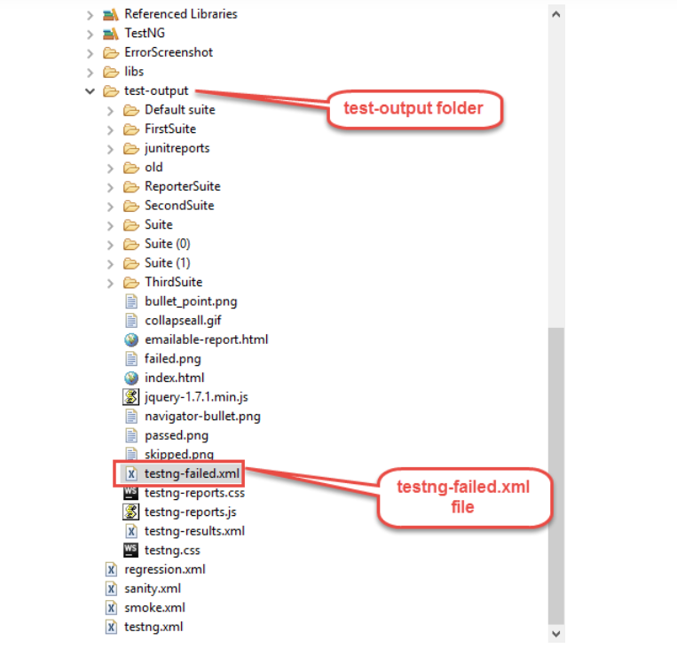
TestNG – Re-run Failed tests
Option 1: Re-run Using testng-failed.xml
After running your test suite, TestNG automatically generates a file called testng-failed.xml in the test-output directory.
This file contains only the failed test methods.
Steps:
Run your test suite normally using testng.xml.
Navigate to the test-output folder.
Locate testng-failed.xml.
Run it like any other suite:

Slide 38
Option 2 – Using IRetryAnalyzer
public class RetryAnalyzer implements IRetryAnalyzer {
private int retryCount = 0;
private static final int maxRetryCount = 3;
public boolean retry(ITestResult result) {
if (retryCount < maxRetryCount) {
retryCount++;
return true; }
return false; }}
Test class:
@Test(retryAnalyzer = RetryAnalyzer.class)
public void testMethod() {
Assert.fail(); // Simulate failure
}

Slide 39
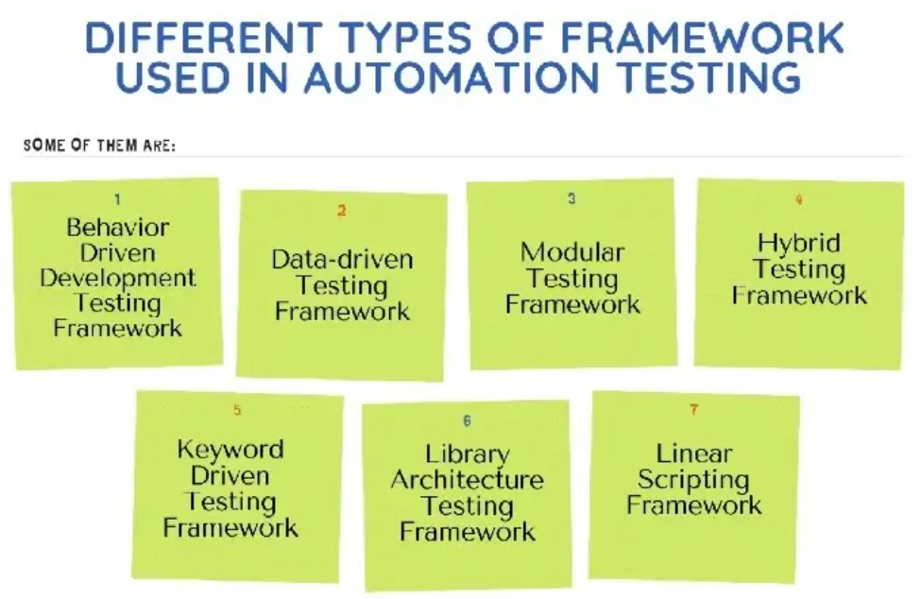
Automation Framework
A structured approach to automate software testing
Provides guidelines, tools, and reusable components
Ensures consistency, scalability, and maintainability
Acts as a foundation for test automation projects

Slide 40
Automation Framework – Key Objectives
Reduce manual effort and human error
Improve test coverage and reliability
Enable faster regression cycles
Support CI/CD integration
Facilitate reusable and modular test scripts

Slide 41
Types of Frameworks
Framework Type | Description
Linear Scripting | Record and playback; simple but not reusable
Modular | Breaks tests into reusable modules
Data-Driven | Uses external data sources for inputs
Keyword-Driven | Uses keywords to represent actions
Hybrid | Combines multiple frameworks for flexibility
Behavior-Driven | Uses Gherkin syntax (e.g., Cucumber) for collaboration

Slide 42
Major Components of a Framework
Test Scripts: Automated test cases
Object Repository: Stores UI element
locators
Data Sources: Excel, CSV, databases, JSON
Utilities: Common functions (e.g., wait, click)
Reports: HTML/XML logs and dashboards
Configuration Files: Environment and test settings

Slide 43
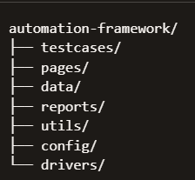
Framework – A First Look

Slide 44
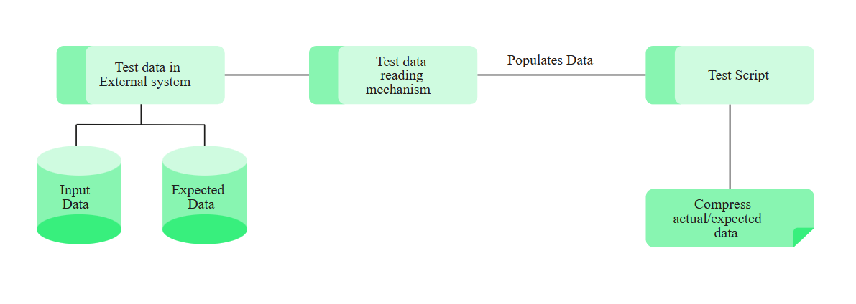
Data Driven Framework
Feature | Description
Parameterization | Inputs are externalized (e.g., Excel, CSV, DB)
Reusable Test Scripts | Same script runs with different data sets
Separation of Concerns | Logic and data are decoupled
Easy Maintenance | Update data without touching code
A test automation design pattern that separates test logic from test data
Allows execution of the same test script with multiple sets of input data
Promotes reusability, scalability, and maintainability

Slide 45
Components of a Data Driven Framework
Component | Function
Test Scripts | Contain the core test logic
Data Source (Excel) | Holds input test data
Driver Script | Loads data & triggers test execution
Reporter Module | Generates test results
Utility Libraries | Handles reading data & logging

Slide 46
When to Use Data-Driven Framework
When testing same functionality with multiple data sets
When test data is frequently changing
For login, registration, form validation scenarios

Slide 47
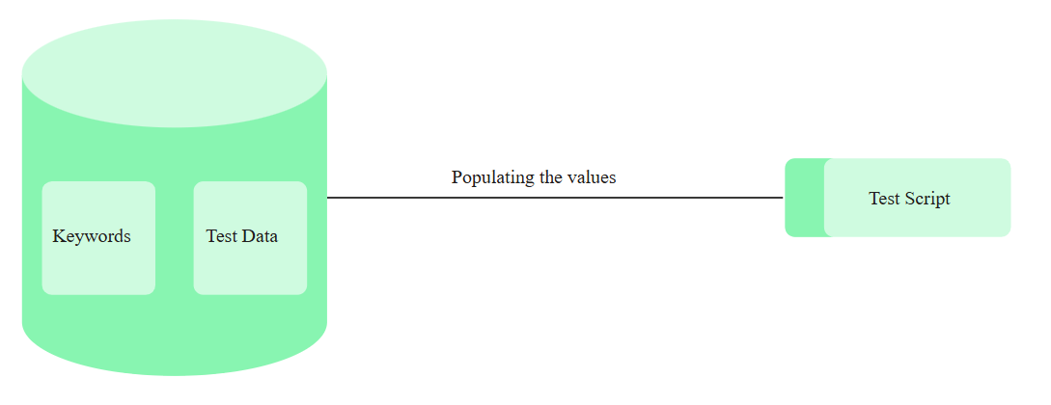
Keyword Driven Framework
Framework that uses keywords to represent actions
Keywords stored in external files (Excel, XML, CSV, DB)
Actual test logic is abstracted away into reusable functions
Example: “Click”, “InputText”, “VerifyLogin”

Slide 48
Core Concept
Test case = sequence of keywords + data
Each keyword maps to a function in the framework
Testers can create scripts with minimal coding knowledge
Facilitates non-technical team members to contribute to automation
Component | Description
Test Case File | Contains keywords and test data
Keyword Library | Repository of keyword-function mappings
Driver Script | Reads keywords and invokes corresponding actions
Utility Classes | For browser handling, logging, screenshots
Reporting Module | Stores and displays results

Slide 49
Example
TestCaseID | Keyword | Object | Value
TC_001 | OpenBrowser | Chrome
TC_001 | Navigate | URL | http://site.com/login
TC_001 | InputText | txtUsername | user1
TC_001 | InputText | txtPassword | pass123
TC_001 | Click | btnLogin
TC_001 | VerifyText | lblWelcome | Welcome user1

Slide 50
When to Use Keyword-Driven Framework
Non-technical users involved in test case creation
Functional testing with repeatable steps
When steps are modular and reusable
Integration into CI/CD pipelines

Slide 51
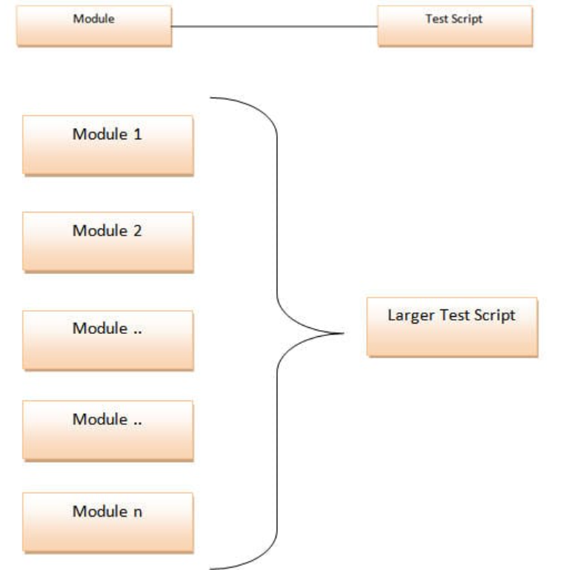
Modular Framework
Framework that divides the test case into separate reusable modules
Each module represents a specific functionality (e.g., login, registration, search)
Test scripts call these modules in desired sequence
Promotes better organization and separation of concerns

Slide 52
Common Components of Modular Framework
Component | Description
Driver Script | Manages execution and invokes modules
Reusable Modules | Scripts for specific features (e.g., login)
Utility Functions | Browser setup, waits, logs, screenshots
Test Data | External file or inline
Reporting Mechanism | Logs pass/fail status of each module

Slide 53
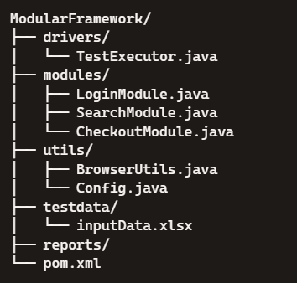
Example

Slide 54
package drivers;
import modules.LoginModule;
import modules.SearchModule;
import modules.CheckoutModule;
import utils.BrowserUtils;
import org.openqa.selenium.WebDriver;
public class TestExecutor {
public static void main(String[] args) {
WebDriver driver = BrowserUtils.initBrowser();
driver.get("https://demoapp.com");
LoginModule.performLogin(driver, "testUser", "testPass");
SearchModule.searchProduct(driver, "Smartphone");
CheckoutModule.checkout(driver);
BrowserUtils.quitBrowser(driver);
}
}

Slide 55
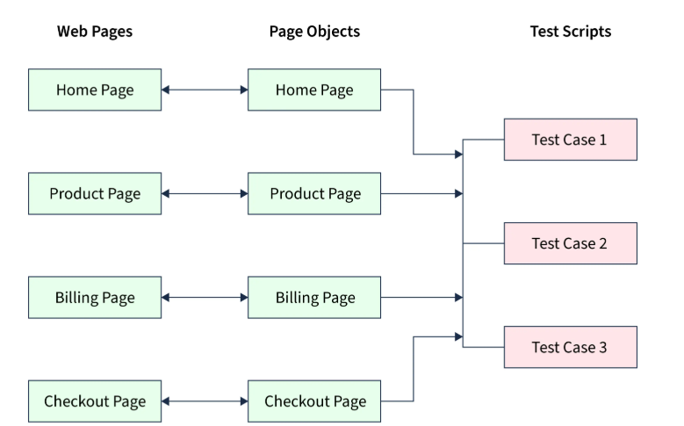
Page Object Model (POM)
Page Object Model is a design pattern used in test automation
Each web page is represented as a Java class
Encapsulates page elements and interactions
Promotes reusable, maintainable code

Slide 56
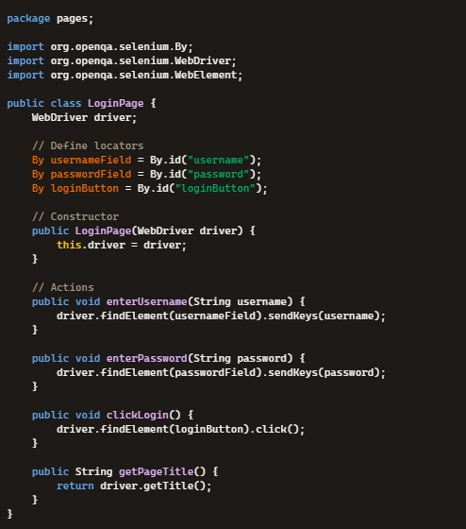

Slide 57
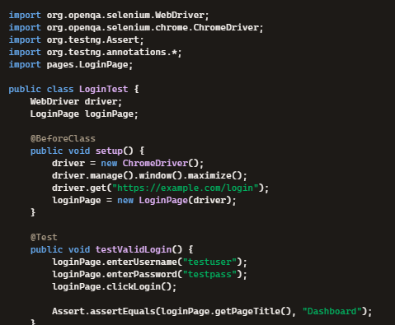


Slide 58

Advantages of POM
Improves test code reusability
Easier bug tracking and debugging
UI changes impact only corresponding page class
Supports integration into hybrid/data-driven frameworks

Slide 59
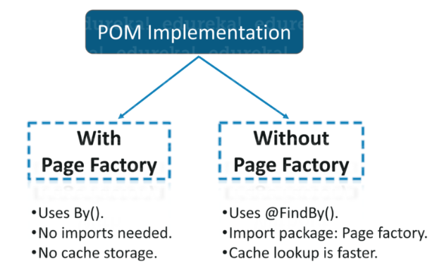
Page Factory
web elements annotated with @FindBy
Lazily loads elements when they are first used
Enhances object creation with cleaner syntax
Example:
@FindBy(how = How.ID, using = "username")
WebElement txtUsername;
@FindBy(id = "username")
WebElement txtUsername;

Slide 60
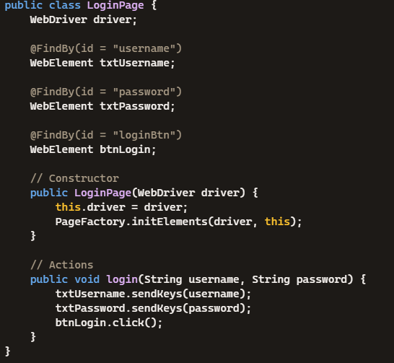
Example

Slide 61
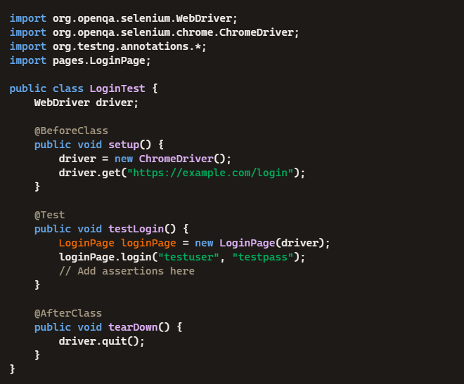
Example

Slide 62
Advantages of Page Factory
Cleaner and more readable page classes
Automatic initialization of web elements
Reduces boilerplate code
Supports lazy element loading

Slide 63

Generating Reports for Framework – Extent Reports
A reporting library for test automation frameworks
Provides interactive, media-rich HTML reports
Captures test steps, screenshots, logs, and status indicators
Compatible with Selenium, TestNG, JUnit, and Cucumber

Slide 64
Steps to Generate extent report in testng
Step 1: Add Maven dependency to pom.xml
<dependency>
<groupId>com.aventstack</groupId>
<antiacid>extentreports</artifactId>
<version>5.0.9</version>
</dependency>
Step 2: Create instances for ExtentReport and ExtentTest classes
ExtentSparkReporter htmlReporter = new ExtentSparkReporter("reports/ExtentReport.html");
ExtentReports extent = new ExtentReports();
extent.attachReporter(htmlReporter);
ExtentTest test = extent.createTest("Login Test");

Slide 65
Step 3: Add content to report using ExtentTest class
test.log(Status.INFO, "Test Started");
test.pass("Login successful");
test.fail("Login failed");
test.skip("Testskipped");
test.addScreenCaptureFromPath("screenshots/failure.png");
Push Changes to Report
extent.flush();

Slide 66
Allure Reports
Open-source test reporting tool
Generates interactive HTML reports
Supports multiple languages and frameworks
Easy to integrate with CI/CD pipelines

Slide 67
How to Generate Allure Reports
add allure-testng dependency
<dependency>
<groupId>io.qameta.allure</groupId>
<artifactId>allure-bom</artifactId>
<version>2.24.0</version>
<type>pom</type>
<scope>import</scope>
</dependency>
<dependency>
<groupId>io.qameta.allure</groupId>
<artifactId>allure-testng</artifactId>
<version>2.24.0</version>
<scope>test</scope>
</dependency>

Slide 68
Add Allure plugin to pom.xml
<plugins>
<plugin>
<groupId>io.qameta.allure</groupId>
<artifactId>allure-maven</artifactId>
<version>2.10.0</version>
<executions>
<execution>
<id>allure-report</id>
<phase>verify</phase>
<goals>
<goal>report</goal>
</goals>
</execution>
</executions>
</plugin>
</plugins>

Slide 69
add @Description, Allure.step to script for steps
@BeforeMethod
public void beforeMethod() {
testAutomationPage test = new testAutomationPage(driver);
Allure.step("Navigate to homepage");
driver.get("http://www.rahulshettyacademy.com/AutomationPractice/");
driver.manage().timeouts().implicitlyWait(Duration.ofSeconds(30));
driver.manage().window().maximize();
}
@Test
@Description("Test case 1 - verify title")
public void testPageTitle() {
try {
testAutomationPage test = new testAutomationPage(driver);
Assert.assertTrue(test.returnPageTitle().equals(test.pageTitle));
Allure.step("Verified Landing Page Title");
}
catch(Exception e) {
e.printStackTrace();
Assert.fail(e.getMessage());
}

Slide 70
run script, get allure-results generated
once done,open cmd in project folder and hit below command:
allure generate allure-results --clean -o allure-report
then hit below command to view report:
  allure serve allure-results

Slide 71
Logging Using Log4J
A powerful logging framework for Java
Developed by Apache Software Foundation
Helps capture runtime information during test execution
Supports multiple output destinations: console, file, database

Slide 72
Log4J Architecture
Component | Description
Logger | Captures log messages
Appender | Defines where logs are written (file, console)
Layout | Formats the log output
Configuration | XML or properties file to control behavior

Slide 73
Log Levels
ALL: Logs everything
DEBUG: Detailed info for debugging
INFO: General runtime information
WARN: Potential issues
ERROR: Serious problems
FATAL: Critical errors causing crash
OFF: Disables logging

Slide 74
How to add logging to Framework
Include Log4j Dependency
<dependency>
<groupId>log4j</groupId>
<artifactId>log4j</artifactId>
<version>1.2.17</version>
</dependency>

Slide 75
Add log4j.properties file to src/test/resources folder
# Root logger
log4j.rootLogger=DEBUG, file, console
# Console Appender
log4j.appender.console=org.apache.log4j.ConsoleAppender
log4j.appender.console.layout=org.apache.log4j.PatternLayout
log4j.appender.console.layout.ConversionPattern=%d [%t] %-5p %c - %m%n
# File Appender
log4j.appender.file=org.apache.log4j.FileAppender
log4j.appender.file.File=logs/testlog.log
log4j.appender.file.layout=org.apache.log4j.PatternLayout
log4j.appender.file.layout.ConversionPattern=%d %-5p [%c] %m%n

Slide 76
Create Logger instance in the test class to log statements
private static final Logger log = Logger.getLogger(logClass.class);
@Test
public void testLogin() {
log.info("Starting login test");
// Selenium steps
log.debug("Entering username");
log.debug("Entering password");
log.info("Clicking login button");
log.warn("Login button response delayed");
log.error("Login failed due to invalid credentials");
}

Slide 77
Listeners
Listeners are interfaces that monitor test execution events
They allow custom actions when tests start, pass, fail, or skip
Useful for logging, reporting, retrying, and debugging

Slide 78
Why Use Listeners in Automation?
Capture
Capture screenshots on failure
Generate
Generate custom reports (e.g., Extent Reports)
Retry
Retry failed tests automatically
Log
Log test steps and exceptions
Track
Track test lifecycle events

Slide 79
Types of Listeners
Listener Interface | Purpose
ITestListener | Monitors test methods (start, success, fail)
ISuiteListener | Tracks suite-level events
IInvokedMethodListener | Hooks before/after any method invocation
IRetryAnalyzer | Re-runs failed tests
IAnnotationTransformer | Modifies annotations at runtime
IReporter | Generates custom reports

